Slide 1
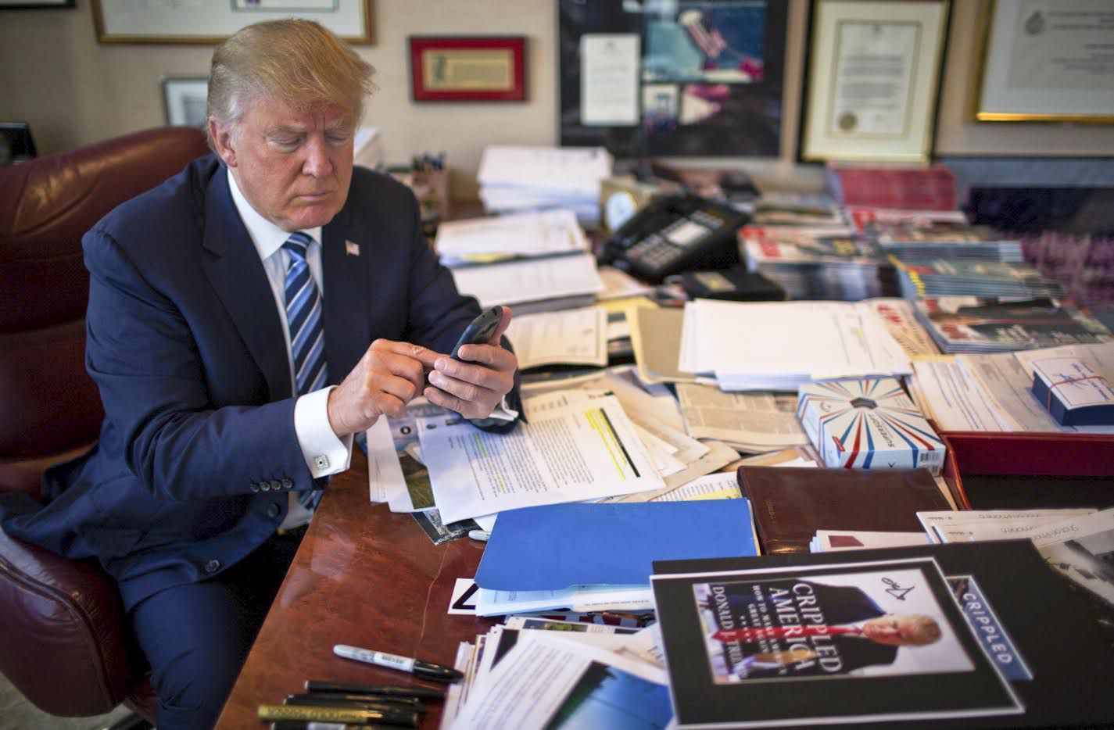
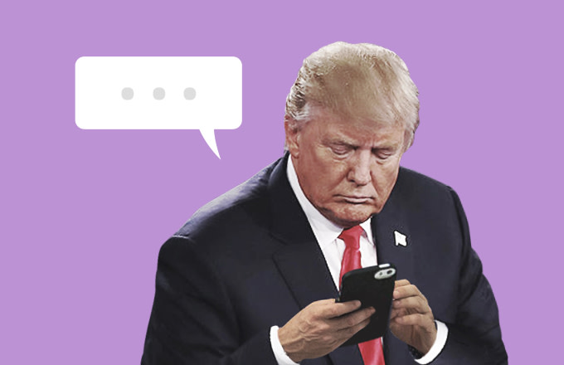
Popular Tweet Times of Donald J. Trump and Vocabulary
Adrian Sandoval-Vargas

Slide 2
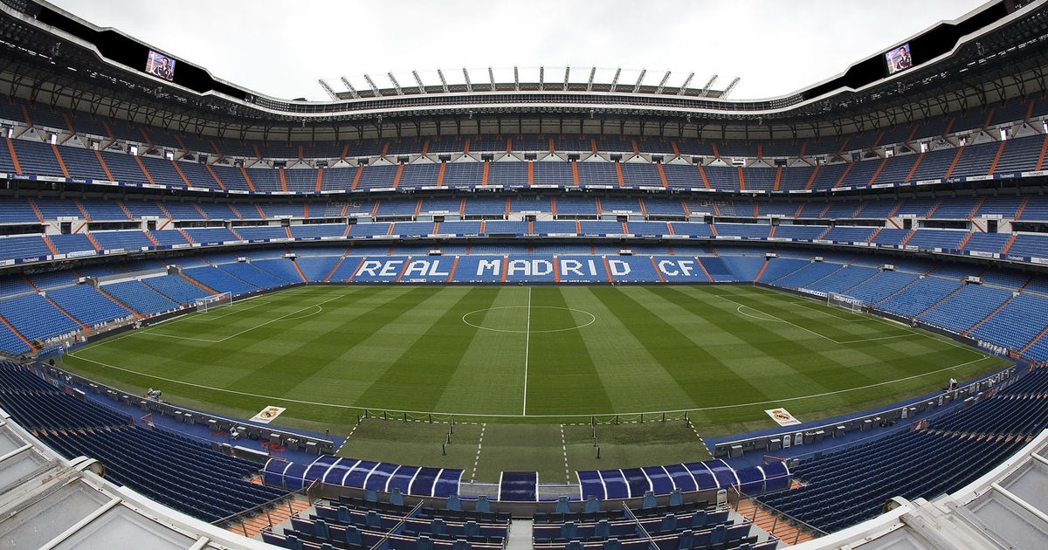
Popular Players in European Football
Adrian Sandoval-Vargas

Slide 3






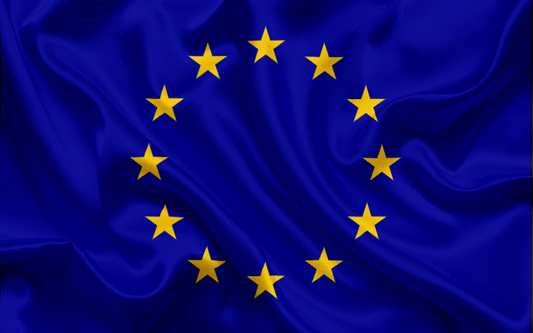
Leagues

Slide 4
Data
Fetching
@LaLiga, @premierleague, @Championsleague
Twitter
Limits ~3,234 tweets
Top Tweeters
Premier league (9/12/2019 – 12/04/2019)
La Liga (8/25/2019 – 12/04/2019)
Champions League (5/7/2019 – 12/04/2019)

Slide 5
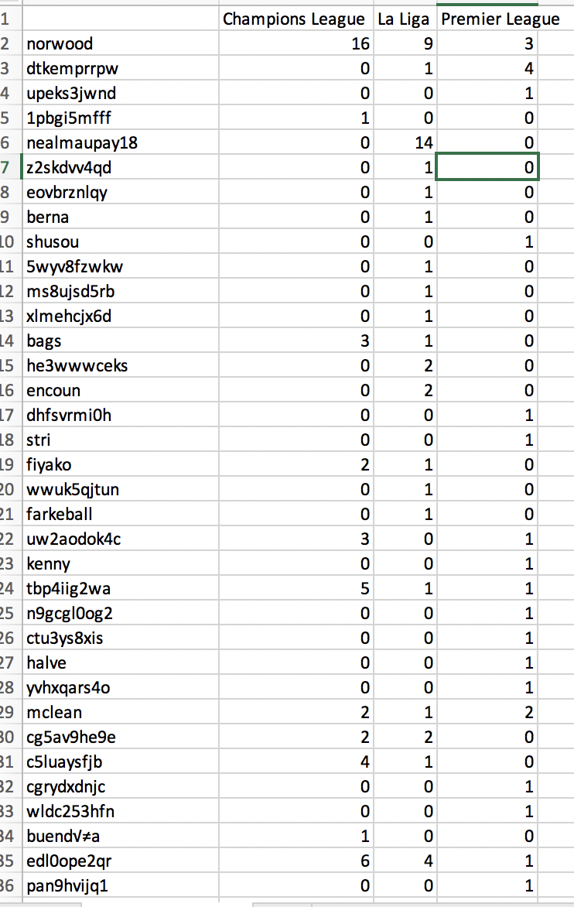
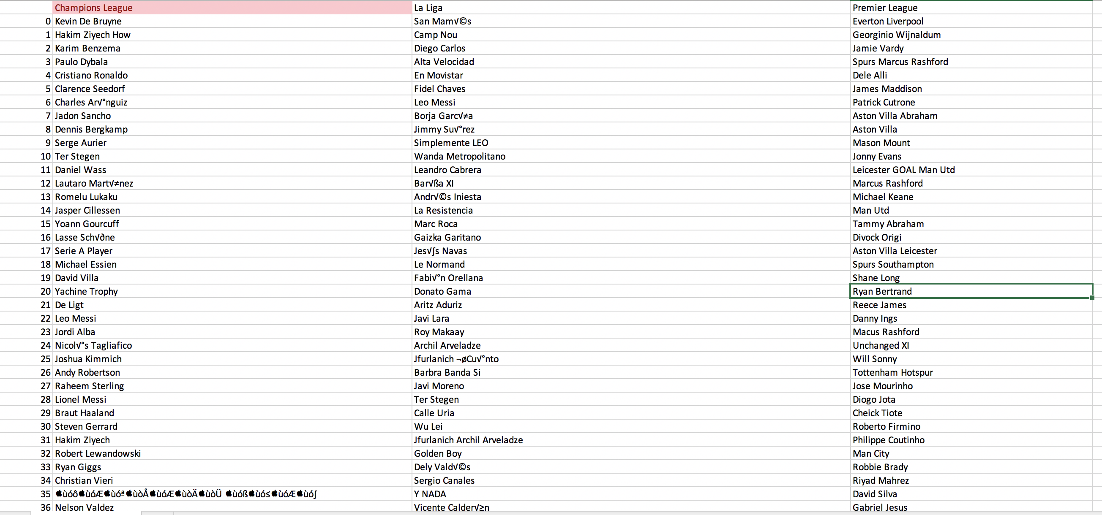
Data

Slide 6

Back To Donald J. Trump
Fetching
@realDonaldTrump
Twitter
158 Tweets (idk why it limits me, National Security?)
No Retweets

Slide 7
Tools
Tweepy
Library to fetch api calls to twitter
Standard python data processing libraries (nltk, sklearn)

Slide 8
Data
Extracted in utf-8
For handling need to decode back to ascii
Date and Time depend on location
Date text 0 2019-12-05 03:50:35 ....”I would like to have the Attorney General... 1 2019-12-05 03:50:35 When I said, in my phone call to the President... 2 2019-12-05 00:03:14 Just read the best Maureen Dowd column, in the... 3 2019-12-04 22:43:19 .@NATO has now recognized SPACE as an operatio... 4 2019-12-04 22:36:31 The Fake News Media is doing everything possib... .. ... ... 154 2019-11-20 19:04:30 I WANT NOTHING! https://t.co/KKUfwSIRAi 155 2019-11-20 18:57:07 ....”I WANT NOTHING! I WANT NOTHING! I WANT NO... 156 2019-11-20 18:57:06 Impeachment Witch Hunt is now OVER! Ambassador... 157 2019-11-20 18:45:36 We join families of Kevin King &amp; Tim Weeks... 158 2019-11-20 18:03:40 https://t.co/HbgEgZsPZ9

Slide 9
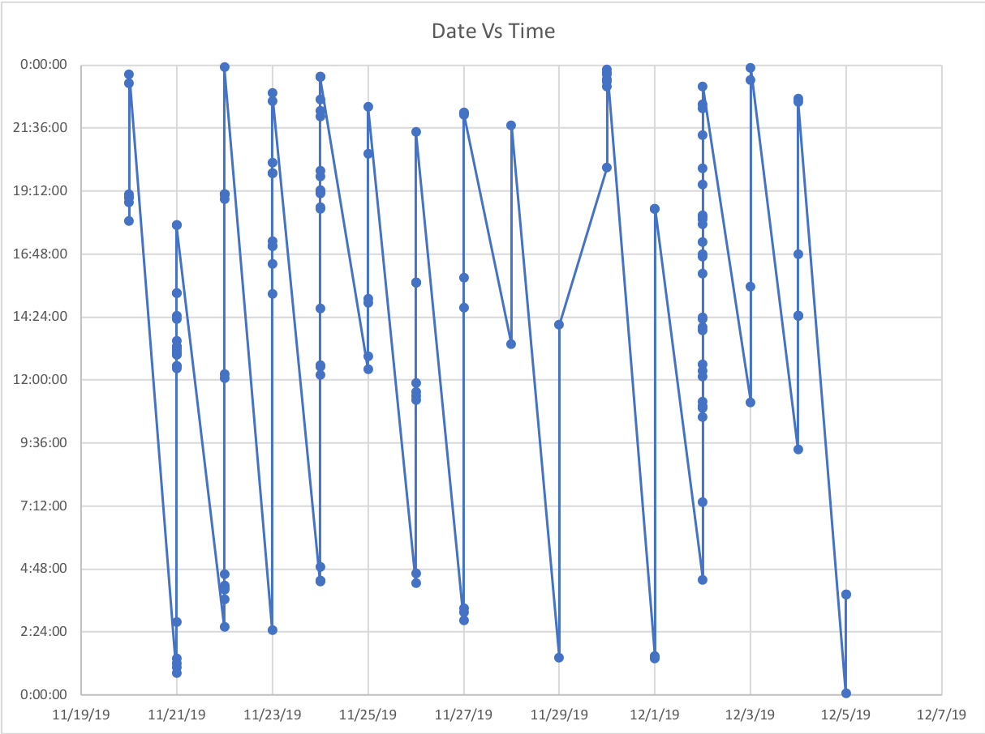
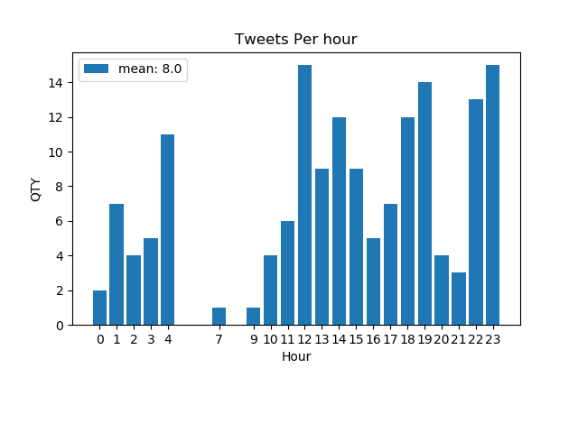
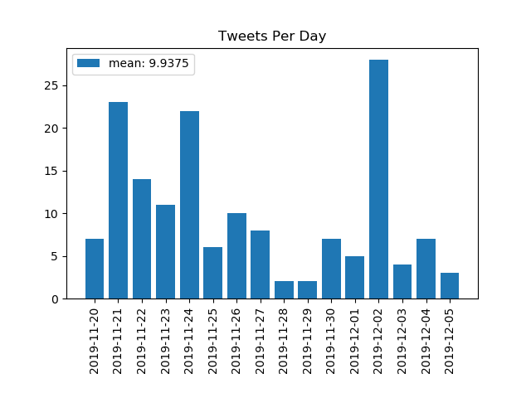
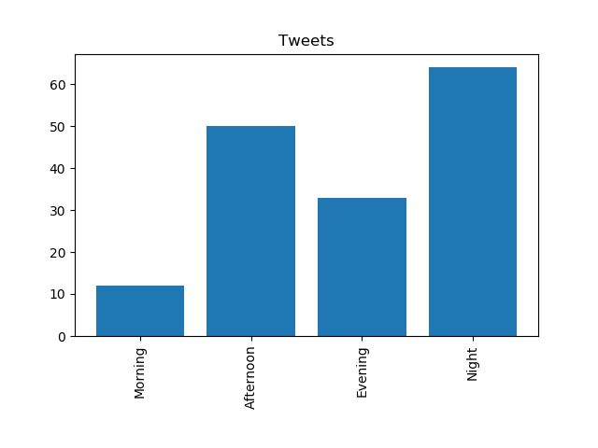
Data - Time
What kept him tweeting almost all day?

Slide 10
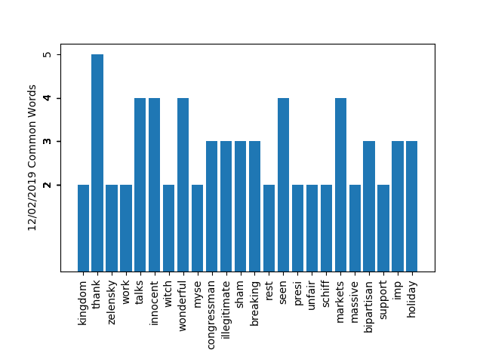
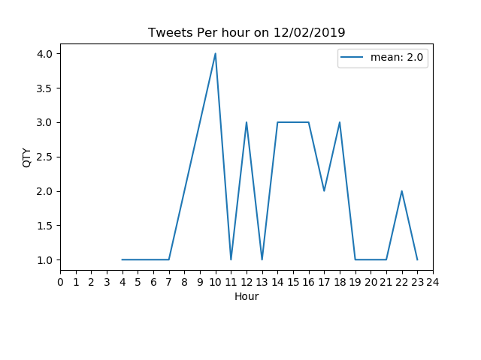
Data - Vocabulary
['Mike Bloomberg’, 'Lisa Page’,
'Peter Strzok', 'Adam Schiff’,
'Speaker Pelosi', 'Trump Economy Breaks', 'Doug Wead', 'Donald Trump']
cline4virginia,1
remarks,1
morning,1
illegitimate,3
hoax,1
wcmmi7q7q2,1
europe,1
represent,1
country,1
fight,1
hard,1
american,1
people,1
pu,1
gekugvw7sj,1
constitutional,1
lawyers,1
need,1
6xh3iq7bsk,1
law,1
enforcers,1
turn,1
breakers,1
totally,1
upended,1
rule,1
sa,1
thjhcx6lqv,1
don,1
evidence,1
going,1
sham,3
scgeo0pu5o,1
breaking,3
ukraine,1
announced,1
trump,1
wrong,1
atgsntphk6,3
states,1
outperformed,1
rest,2
world,1
eye,1
popping,1
fashion,1
ve,1
seen,4
numbe,1
4luj6dpgl2,1
political,1
effort,1
presi,2
7dff3j8rev,1
process,1
unfair,2
republicans,1
witnesses,1
gets,1
adam,1
schiff,2
dnil5o1wod,2
markets,4
21,1
announcement,1
tariffs,1
2018,1
taking,1
massiv,1
jxjxnw8gll,1
reserve,1
likewise,1
act,1
countries,1
longer,1
advantage,1
htkwe89s8a,1
brazil,1
argentina,1
presiding,1
massive,2
devaluation,1
currencies,1
good,1
fpoecstlmq,1
clear,1
bipartisan,3
support,2
speaker,1
pelosi,1
said,1
months,1
essential,1
imp,3
ae0wyng7k1,1
economy,1
breaks,1
holiday,3
shopping,1
records,1
foxnews,1
writer,1
historian,1
doug,1
wead,1
written,1
true,1
fake,1
account,1
washington,1
9ijcplhrxk,1
donald,1
framed,1
2016,1
mariabartiromo,1
100,1
correct,1
maria,1
let,1
happen,1
mini,1
mike,1
bloomberg,1
instructed,1
rate,1
news,1
organization,1
investigate,1
democrat,1
https,1
w1wsjinu3a,1
just,1
landed,1
united,1
kingdom,2
heading,1
london,1
nato,1
meetings,1
tomorrow,1
prior,1
landing,1
read,1
republ,1
y0em0ks1cq,1
fed,1
lower,1
rates,1
inflation,1
loosen,1
making,1
competitive,1
nations,1
lujdrxg3bv,1
manufacturers,1
held,1
strong,1
dollar,1
propped,1
ridiculous,1
policies,1
eole1xlqze,1
zlfv4mokom,1
thank,5
president,1
zelensky,2
case,1
democrats,1
finally,1
work,2
xrjsusm9wq,1
decades,1
election,1
spending,1
declined,1
thirds,1
members,1
meeti,1
jp7wb8b4hj,1
great,1
job,1
repdougcollins,1
georgia,1
weekend,1
representing,1
republican,1
party,1
impeachment,1
hoax,1
lisa,1
page,1
lover,1
peter,1
strzok,1
talks,4
crushed,1
innocent,4
ask,1
pe,1
utxqn6ge4q,2
scam,1
continuation,1
year,1
witch,2
hun,1
w51pdktm2g,1
did,25
doks_art,1
think,1
fantastic,1
wonderful,4
artist,1
dream,1
lvvcujz5cw,1
senjohnkennedy,1
myse,2
akbwmnfmud,1
congressman,3
ben,1

Slide 11
Events
NATO Summit
Judiciary Committee Begins Impeachment Hearings
…

Slide 12
Future
Still need to process other days
Store @... Tags

